Slide 1

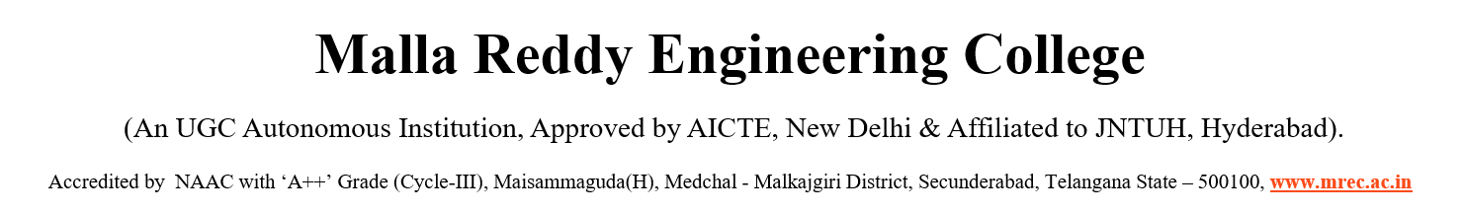

DEPARTMENT OF INFORMATION TECHNOLOGY
MAJOR PROJECT REVIEW
Presentation on
Water Quality Monitoring And Forecasting System
Team Members :
BAIRAGONI VAISHANAVI 22J41A1207
MALOTH THARUN 22J41A1236
POTHUGANTI NIKHIL 23J45A1206
CHANDUPATLA SIDDHARTHA 22J41A1213
Under the guidance of
Dr.Deena Babu Mandru
HOD IT

Slide 2
ABSTRACT
Water pollution refers to the contamination of water bodies through the release of harmful pollutants, posing serious risks to human health and the environment. This study aims to explore machine learning-based techniques for forecasting water quality by achieving the highest possible prediction accuracy. The dataset is analyzed using supervised machine learning techniques (SMLT), incorporating steps such as variable identification, univariate, bivariate, and multivariate analysis, missing value treatment, data validation, cleaning, preparation, and visualization. The analysis also includes a sensitivity study of model parameters to evaluate their impact on prediction performance. The objective is to propose an effective machine learning approach for accurately predicting the Water Quality Index (WQI) by comparing the performance of various supervised classification algorithms. Furthermore, the study evaluates and compares these algorithms using a dataset from the transport traffic department through classification reports, confusion matrix analysis, and priority-based categorization. Results demonstrate that the proposed machine learning techniques are effective in achieving high accuracy and can be validated using precision, recall, and F1 score metrics.

Slide 3
PROBLEM STATEMENT
Problem : Water pollution refers to the contamination of water bodies through the release of harmful pollutants, posing serious risks to human health and the environment. Traditional water monitoring systems are often reactive, relying on delayed or manual analysis, and fail to provide accurate, real-time predictions.
Desired State : The objective is to develop an intelligent, automated system that can continuously monitor and accurately forecast water quality using machine learning. The ideal solution should support proactive environmental management by offering timely insights based on predictive analysis.
Current Gap : There is a lack of unified systems that combine real-time monitoring, intelligent prediction, and analytical insights for water quality. Existing tools often use outdated data or static rules and fail to incorporate adaptive machine learning algorithms for forecasting.

Slide 4
OBJECTIVES
To develop a machine learning-based system for accurate prediction of Water Quality Index (WQI).
To preprocess and analyze water quality data through cleaning, validation, and feature selection techniques.
To compare supervised machine learning algorithms such as Random Forest, SVM, and Logistic Regression for forecasting WQI.
To evaluate model performance using metrics like precision, recall, F1-score, and confusion matrix.
To build a reliable forecasting tool that supports proactive environmental monitoring and decision-making.

Slide 5
LITERATURE SURVEY
Study | Key Contribution | Year
WHO Guidelines (World Health Org) | Defined global standards for drinking water quality and public health guidelines. | 2017
Gholami et al. | Reviewed deep learning models for environmental monitoring and water quality prediction. | 2020
Yun et al. | Studied feature selection techniques for improving model accuracy in environmental datasets. | 2007
Chandrashekar & Sahin | Surveyed feature selection methods applicable in water quality analysis. | 2014
Pal (Remote Sensing) | Applied Random Forest classifier for classification of environmental data using remote sensing. | 2005
Ham et al. | Investigated Random Forest for hyperspectral data, highlighting its use in pollution classification. | 2005
Pedregosa et al. | Introduced the Scikit-learn library for machine learning, widely used in environmental modeling. | 2011
Rao & Reddy | Proposed IoT-integrated frameworks for real-time water quality monitoring using sensors. | 2021
Fang et al. | Demonstrated ML use in environmental forecasting and public safety applications. | 2021
IBM Research | Integrated AI for anomaly detection and decision support in environmental monitoring systems. | 2019

Slide 6
EXISTING SYSTEM
Measures pH, turbidity, temperature, Conductivity, TDS, etc.
Identifies key parameters affecting water quality.
Random Forest Model Training
✔ Splits data into training & testing sets (80% Training , 20% Testing).
✔ Trains multiple Decision Trees.
✔ Uses majority voting for classification.
Predicts if water is Safe, Moderate, or Polluted.
Displays water quality levels & suggests purification methods.

Slide 7
Disadvantages
Cannot predict future water quality variations because it does not handle Time Series Trends.
Training multiple decision trees increases processing time.
Noisy Data or missing values can reduce accuracy.
Requires Large Datasets, Performance drops if data is insufficient or imbalanced

Slide 8
PROPOSED SYSTEM
Hybrid LSTM(Long short-Term Memory) + Random Forest Algortihm Based Water Quality Monitoring.
Uses real-time sensor readings + past water quality data for better accuracy.
Forecasts future values of pH, turbidity, TDS,etc., capturing seasonal variations using LSTM Algorithm.
Categorizes water quality as Safe, Moderate, or Polluted based on predicted & real-time values using Random Forest Algorithm.
LSTM detects trends, while RF enhances classification precision.
Reduces misclassification by handling both temporal patterns & feature correlations.
Can be expanded with more sensors, new features, or additional ML models.

Slide 9
Advantages
By combining the strengths of LSTM for time-series forecasting and Random Forest for classification, the system improves overall prediction accuracy for water quality parameters like pH, turbidity, and TDS.
The use of LSTM enables the system to learn from past data, identifying long-term patterns and seasonal changes in water quality, which traditional classifiers cannot detect.
The use of LSTM enables the system to learn from past data, identifying long-term patterns and seasonal changes in water quality, which traditional classifiers cannot detect.
Integrates real-time sensor inputs with historical datasets for better context-aware decision-making and forecasting.
Early prediction of water pollution risks helps authorities take timely preventive actions, improving public health and resource planning

Slide 10
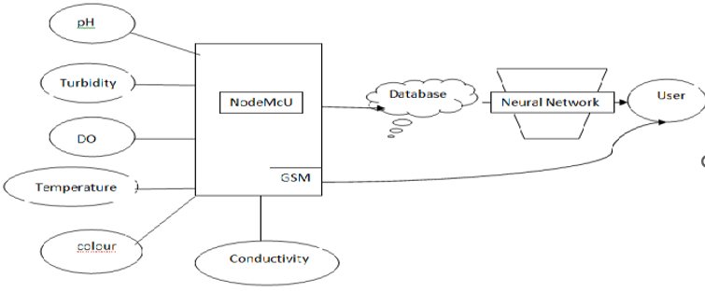
SYSTEM ARCHITECTURE

Slide 11
Technologies & ML Techniques Used in the Project
📌 Machine Learning Models Applied:
Random Forest Classifier
Long short Term Memory(LSTM): for time series forecasting
📌 Technologies Used:
Programming Language: Python 3.10.0
Libraries & Tools:
Data Processing: Pandas, NumPy
Visualization: Matplotlib
Machine Learning: Scikit-learn
Time-Series Environment:Keras
Backend Framework: Django(for web interface)
Dataset : Water Quality Data set
Tool : Jupyter Notebook
📌 AI/ML Techniques Used:
Feature Engineering:
Selected key water quality parameters(pH,TDS,Turbidity etc)
Data Cleaning:
Handled missing values,removed outliers
Normalized data for better model performance
Split the data into training and testing sets (80/20)

Slide 12
Sample Code
# 3. LSTM Classifier
X_seq = X.reshape(X.shape[0], X.shape[1], 1)
Y_cat = to_categorical(Y)
LSTM(100, input_shape=(X_tr.shape[1], 1)), Dropout(0.5),
Dense(100, activation='relu'),
X_tr, X_te, y_tr, y_te = train_test_split(X_seq, Y_cat, test_size=0.2)
lstm = Sequential([
])
lstm.compile(loss='binary_crossentropy', optimizer='adam', metrics=['accuracy'])
lstm.fit(X_seq, Y_cat, epochs=40, batch_size=32)
# 4. Water Turbidity Forecasting (Regression)
forecast_data = data[['tds','turbidty','ph','conductivity','temperature']]
Yf = forecast_data[['turbidty']].values
Xf = forecast_data.drop(['turbidty'], axis=1).values
sc = MinMaxScaler()
Xf = sc.fit_transform(Xf)
Yf = sc.fit_transform(Yf)
Xf_train, Xf_test, Yf_train, Yf_test = train_test_split(Xf, Yf, test_size=0.2)
reg = RandomForestRegressor().fit(Xf_train, Yf_train.ravel())
pred_f = sc.inverse_transform(reg.predict(Xf_test).reshape(-1,1))
# 1. Data Preprocessing
data = pd.read_csv("Dataset/ml.csv")
data.fillna(0, inplace=True)
X = data.iloc[:, 2:-1].values
Y = data.iloc[:, -1].astype(int).values
# 2. Random Forest Classifier
X_train, X_test, y_train, y_test = train_test_split(X, Y, test_size=0.2)
rf = RandomForestClassifier()
rf.fit(X_train, y_train)
pred_rf = rf.predict(X_test)
Dense(y_tr.shape[1], activation='softmax')

Slide 13
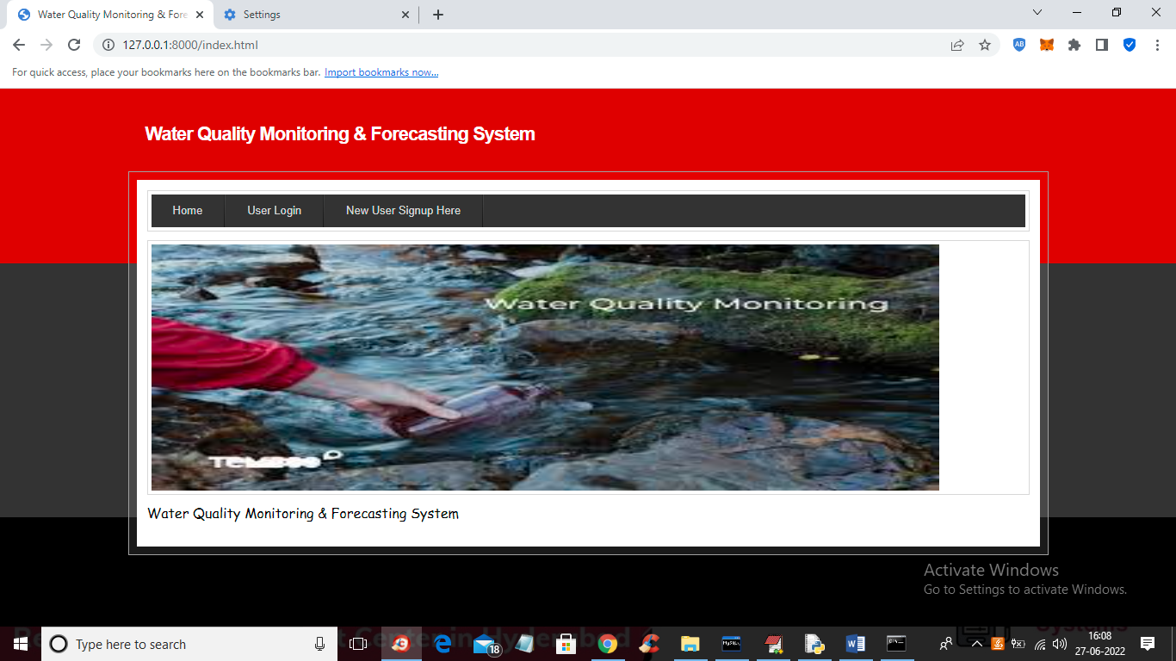
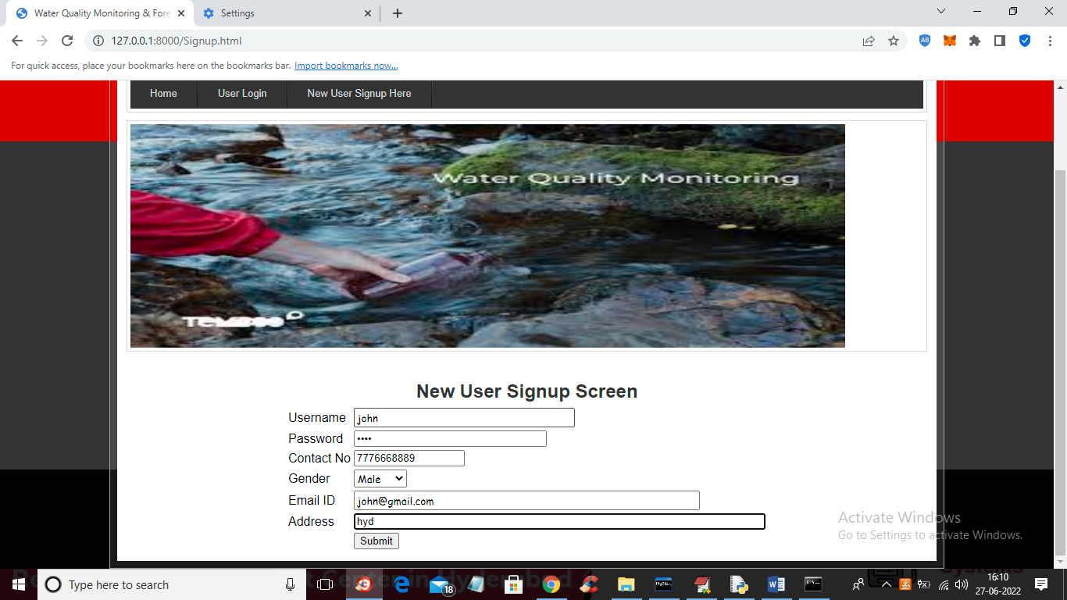
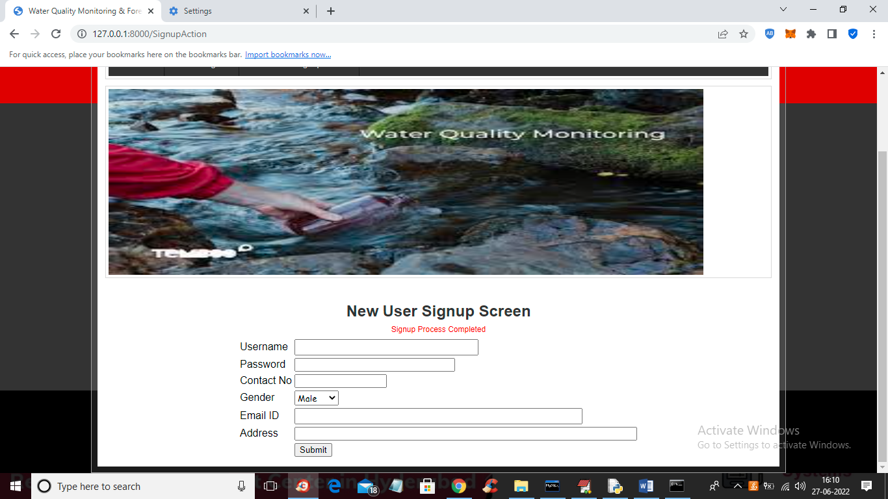
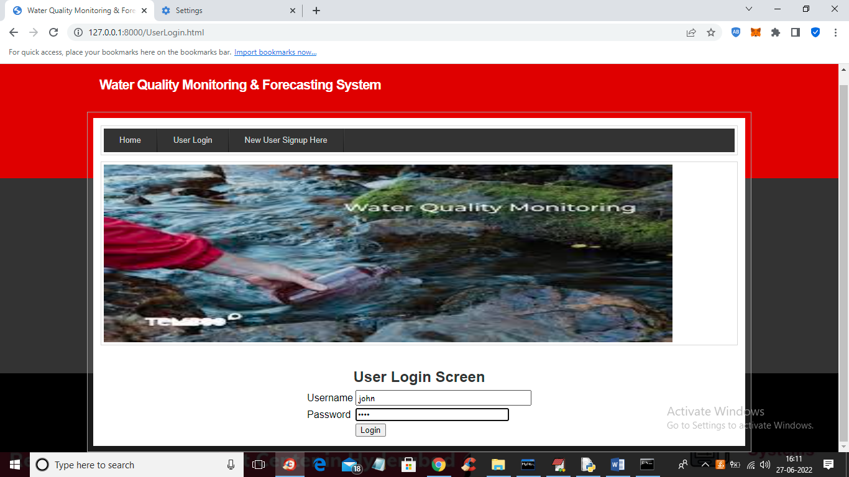
RESULT

Slide 14
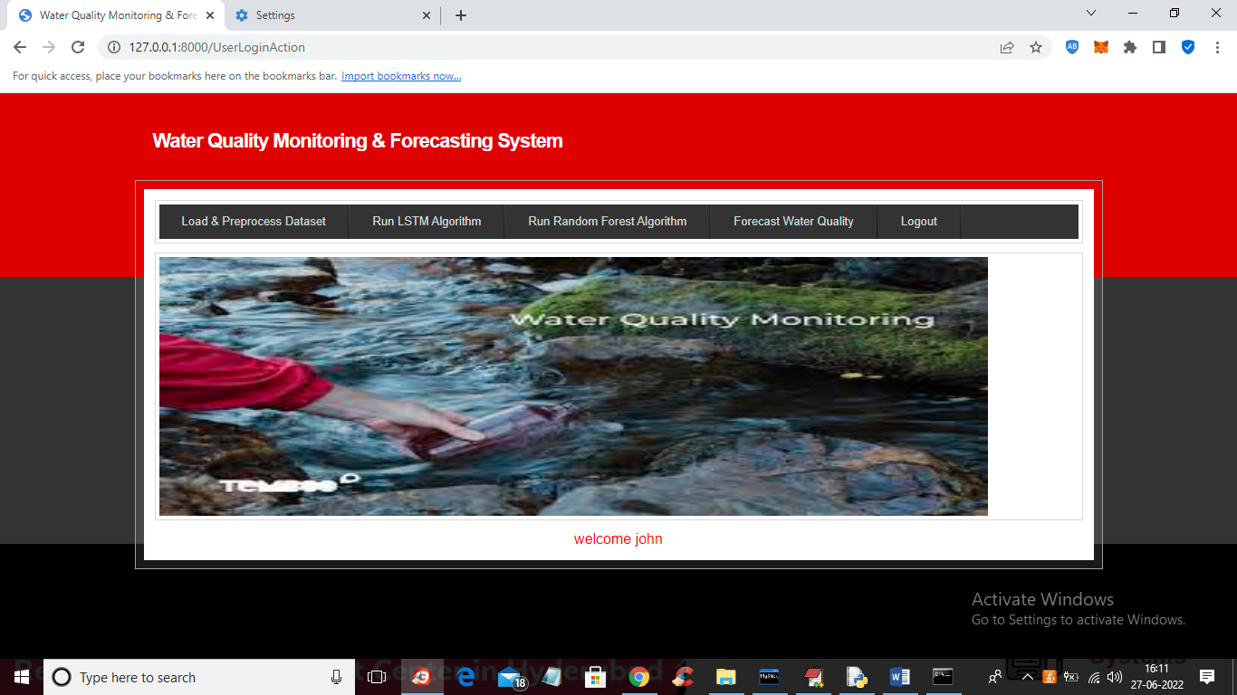
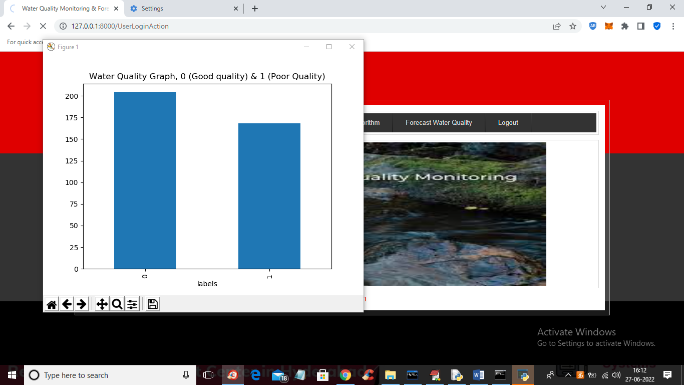
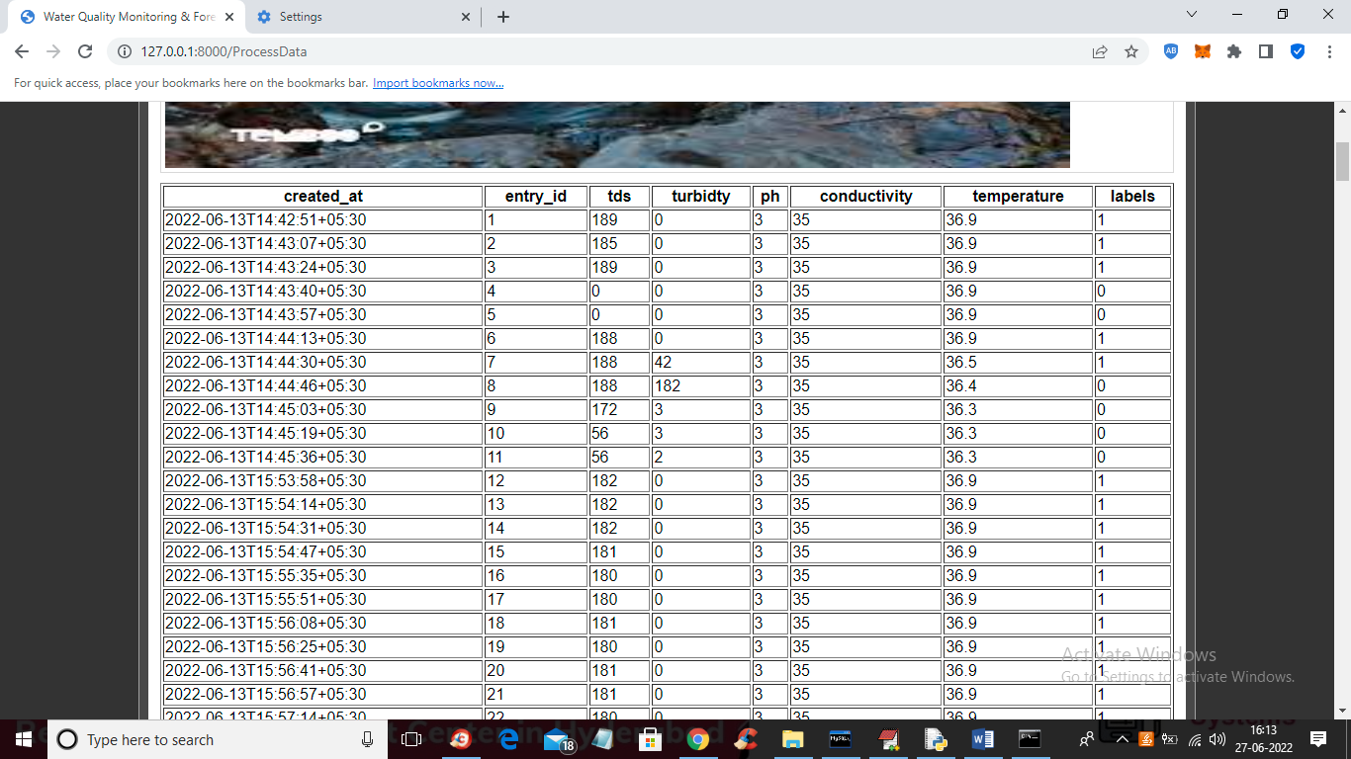
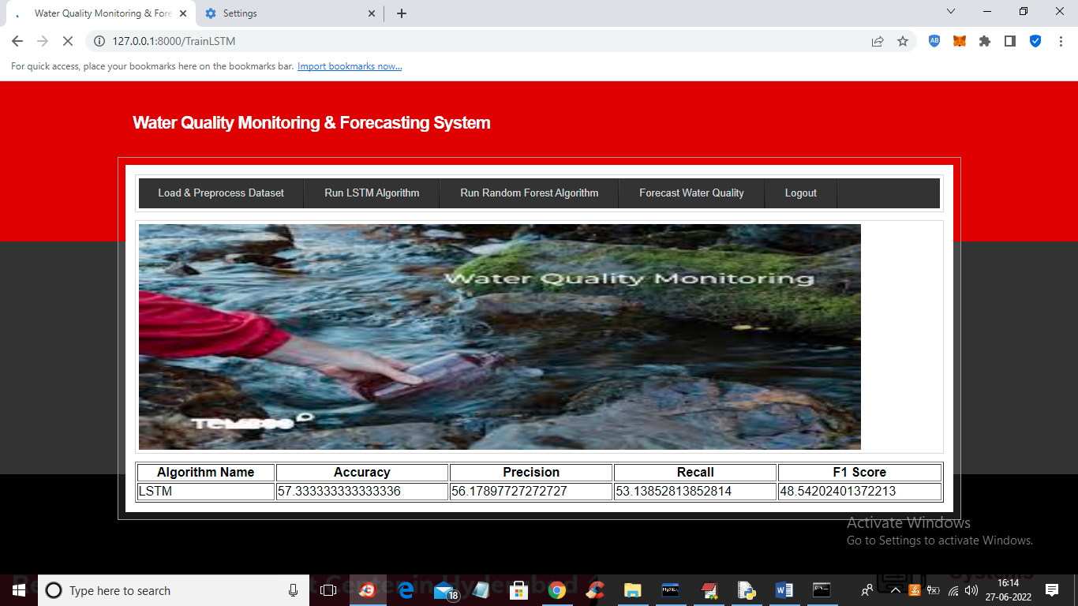

Slide 15
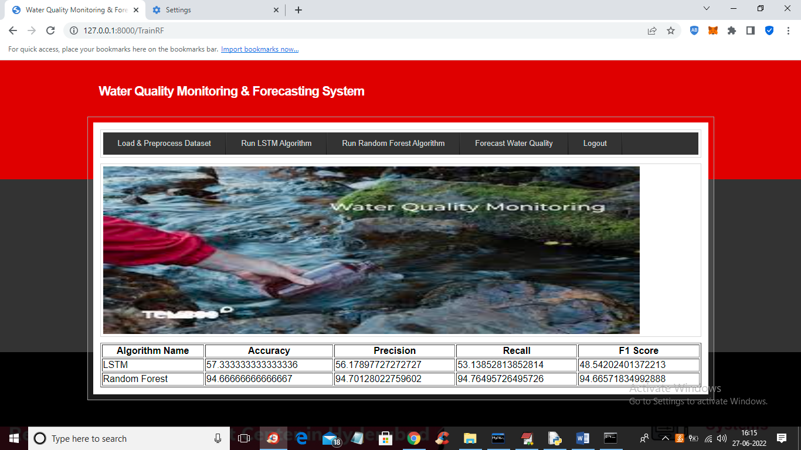
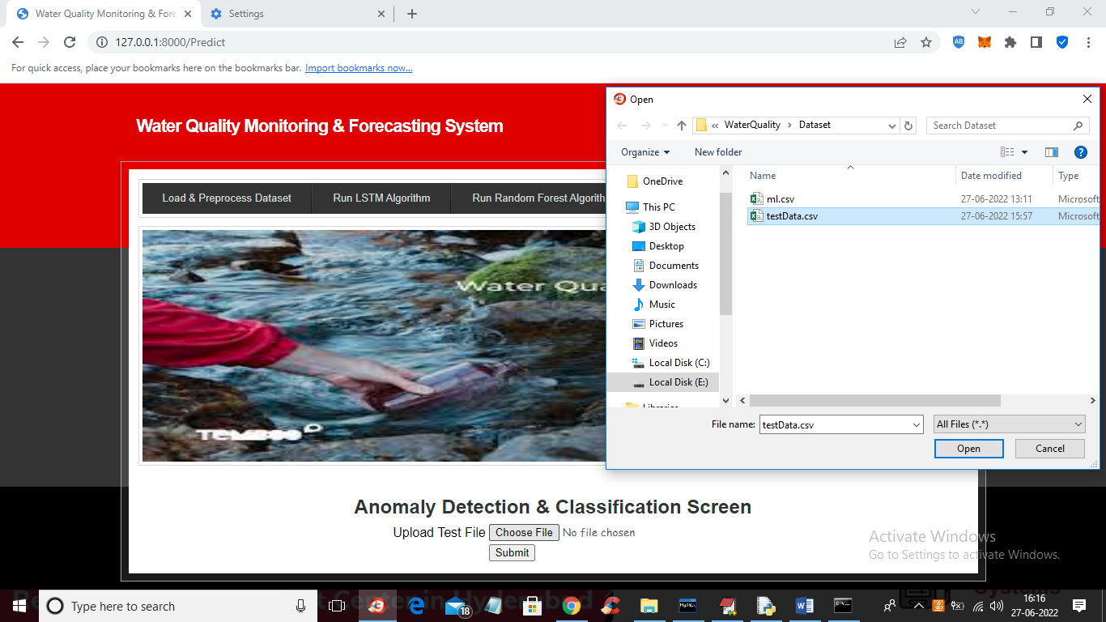
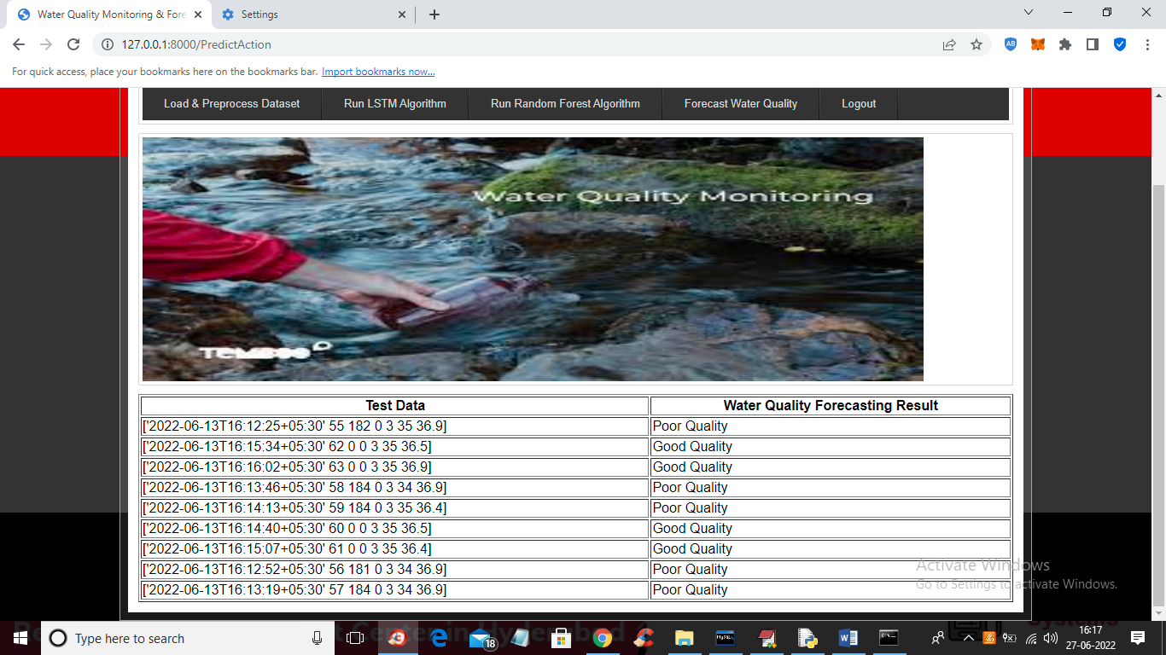

Slide 16
Future Enhancements
Integration of Real-Time Sensor Networks
Deploy multiple sensor nodes across different water bodies to enable continuous, real-time monitoring and streaming of data into the prediction system
Mobile App Development
Build a user-friendly mobile application to allow users and authorities to receive instant alerts, view water quality forecasts, and access purification recommendations on the go.
User Alert System
Send warnings to users when water is unsafe using SMS, email, or app notifications

Slide 17
CONCLUSION
This project presents a hybrid LSTM and RF-based water quality monitoring system that improves accuracy by combining time-series forecasting and classification. While LSTM predicts future water quality trends, RF classifies current conditions to provide real-time insights. The system ensures efficient monitoring, early contamination detection, and data-driven decision-making. With scalability and adaptability, it can be further enhanced through IoT integration, AI-driven recommendations, and additional parameters, making it a robust solution for ensuring water safety.

Slide 18
REFERENCES
1 .World Health Organization, Guidelines for Drinking-water Quality, 4th ed., Geneva, Switzerland: WHO Press, 2017.
2. B. J. Hao Cen, K. Koedinger, and Carnegie, "Learning Factors Analysis – A General Method for Cognitive Model Evaluation and Improvement," in Proc. Int. Conf. Intelligent Tutoring Systems, vol. 8, pp. 164–175, 2006.
3 .A. Gholami, A. H. Yari, S. Hashemipour, and M. M. Aliabadi, "A comprehensive review of deep learning for water quality monitoring," Environmental Monitoring and Assessment, vol. 192, Art. no. 167, 2020.
4 .C. Yun, D. Shin, H. Jo, J. Yang, and S. Kim, "An Experimental Study on Feature Subset Selection Methods," in Proc. 7th IEEE Int. Conf. Comput. Inf. Technol. (CIT), pp. 77–82, 2007.
5 .G. Chandrashekar and F. Sahin, "A survey on feature selection methods," Computers & Electrical Engineering, vol. 40, no. 1, pp. 16–28, 2014.

Slide 19
THANK YOU

